Slide 1
API and its Stndards

Slide 2

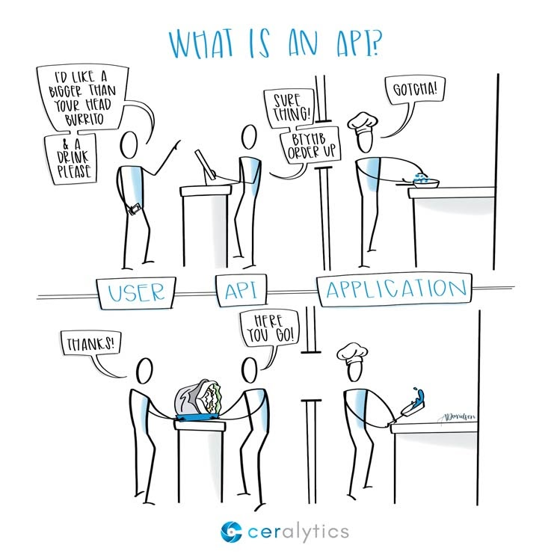

What is an API?
"API stands for Application Programming Interface, which is a software intermediary that allows two applications to talk to each other."
z

Slide 3
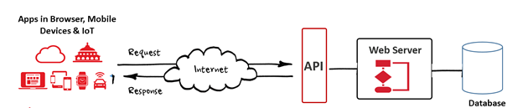
What is an API?
An API is a software which can be used by other softwares, to communicate with other softwares or even hardwares. It acts as a bridge between different softwares and devices.

